Slide 1
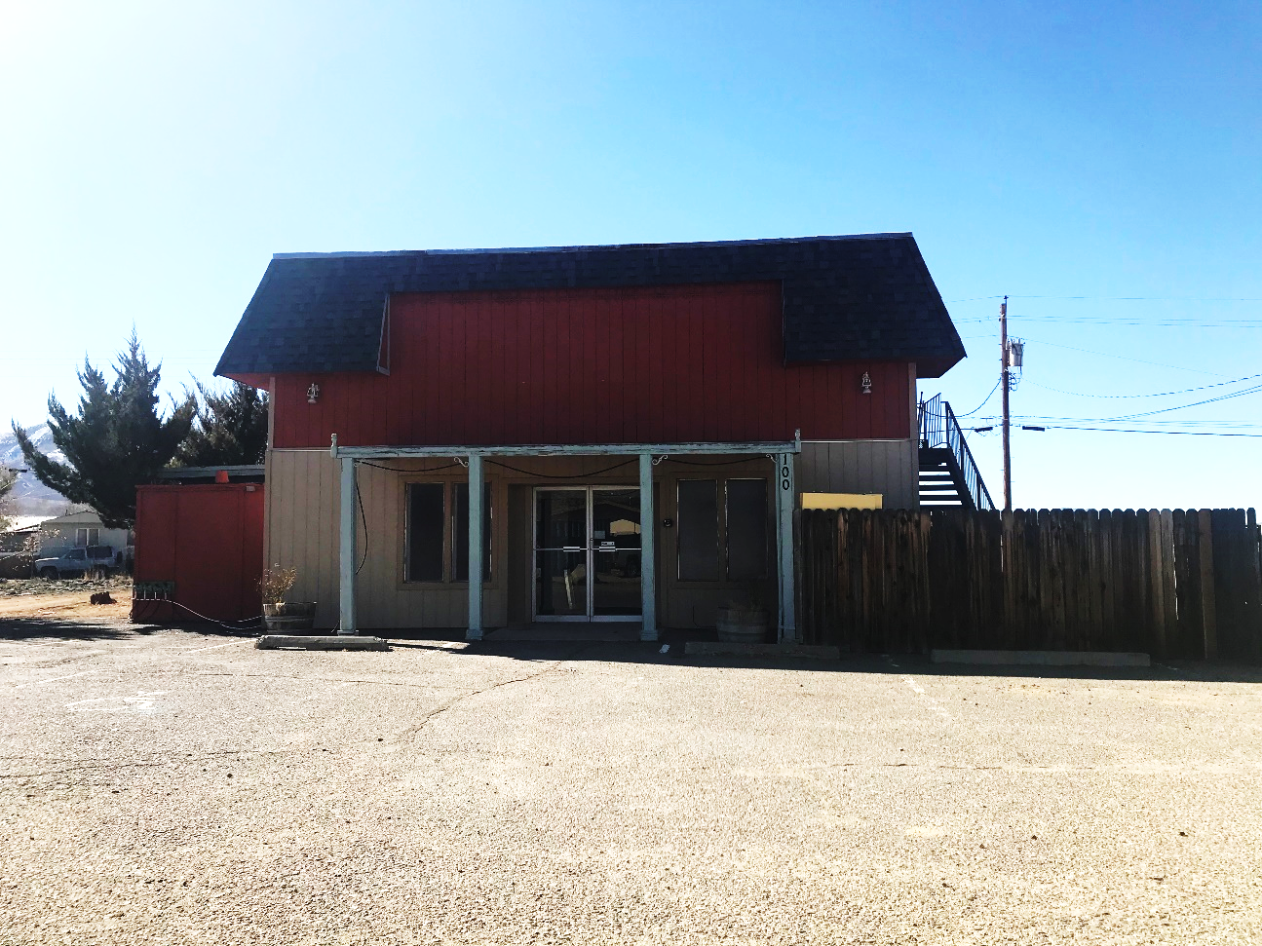
WADMIN20-0002 - APPEAL
(Mommies & Daddies Daycare)
Washoe County Board of Adjustment
February 4, 2020

Slide 2
Appeal Request
This is a request for an appeal of the Community Services Department’s requirement to impose required roadway improvements to Deli Street.
This administrative permit was approved by the BOA in April 2020 for the establishment of a child daycare center that will accommodate up to 45 children from ages 0 to 12 years old

Slide 3
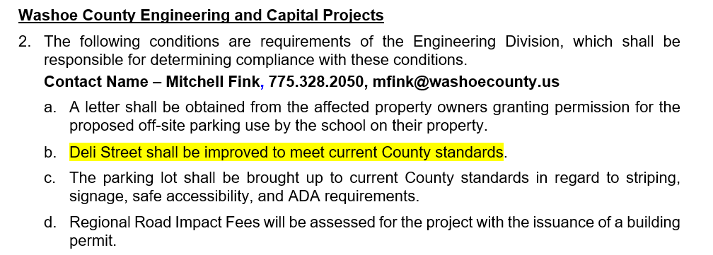
Subject Condition

Slide 4
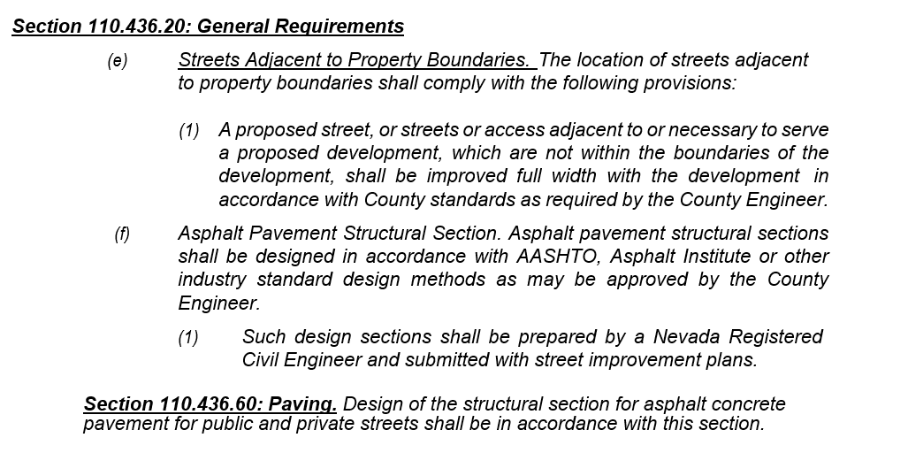
Paving Requirement

Slide 5
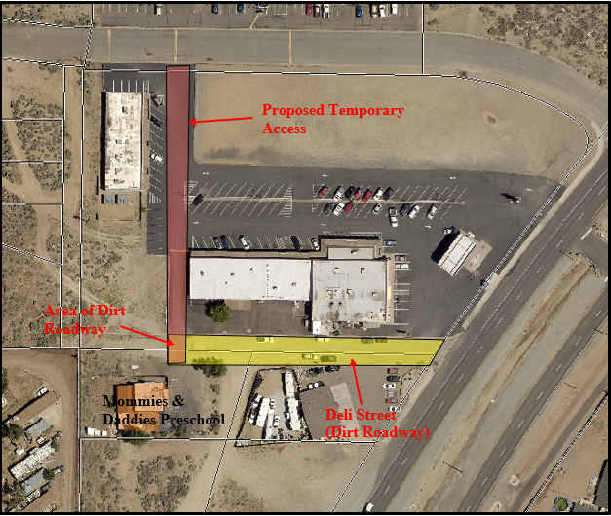
Temporary Access

Slide 6
Reviewing Agencies
Various agencies reviewed the application, their comments are included in the staff report
Agencies with conditions, are included in the Conditions of Approval

Slide 7
Staff Recommendation
Approve the appeal with conditions.
Condition the requirement for an agreement between applicant and Washoe County.
Provide a 3-year timeframe for paving of Deli Street.
Provide construction plans and cost estimates.
Provide temporary access easement through adjacent parcel to the north.

Slide 8
Possible Motion
Motion
I move that, after giving reasoned consideration to the information contained in the staff report and information received during the public hearing, the Board of Adjustment approve with conditions the appeal of staff’s decision for Nikole Jacob-Jones, in accordance with Washoe County Code Section 110.436.20, with the following conditions at a minimum:
1. Enter into an agreement related to the paving of Deli Street between owner/applicant and Washoe County to include: target deadlines, rider insurance, and financial assurances for the project value AND subject to receiving BCC approval for this agreement.
2. Provide a 3-year timeframe for completions for the paving of Deli Street.
3. Provide approved construction plans and cost estimate (including Exhibit A) for the paving of Deli Street to the BCC.
4. Provide temporary access easement on parcel 080-191-20.
5. Other conditions as the Board deems fit to protect public life-safety and welfare.

